Slide 1
Kalman filter fitting
On Laptop ~3FPS

Slide 2
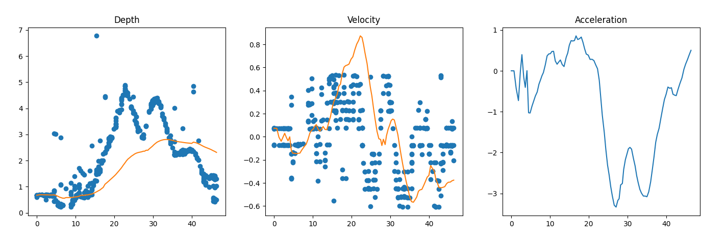
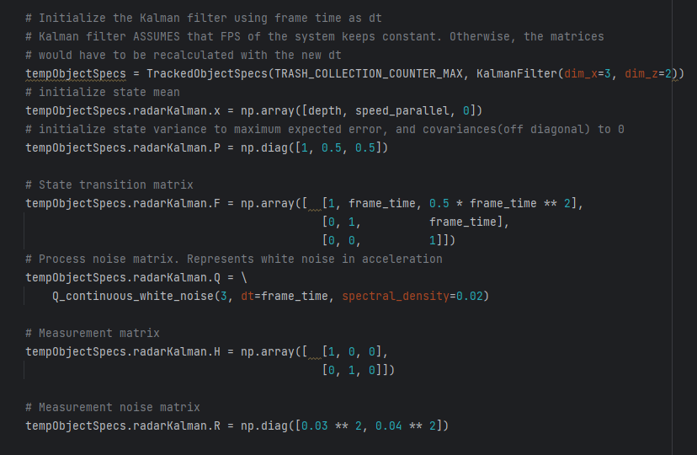
Kannettava. FPS noin 3 -> dT=0,333

Slide 3
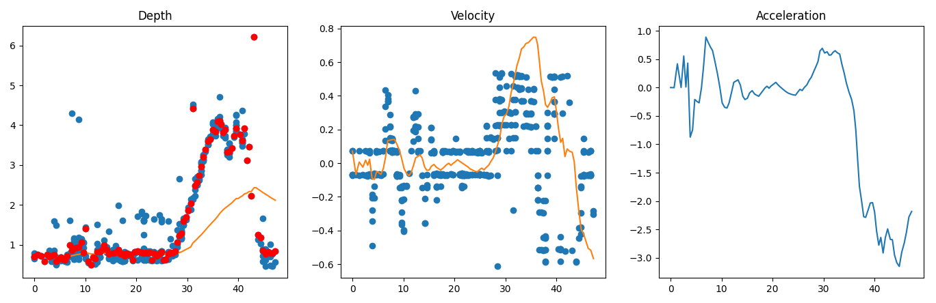
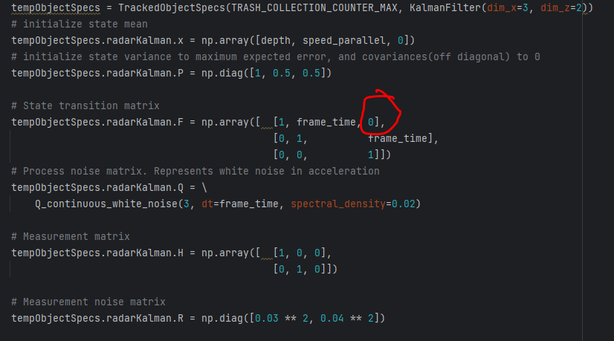
Euler integrated transition matrix
Kannettava. FPS noin 3 -> dT=0,333

Slide 4
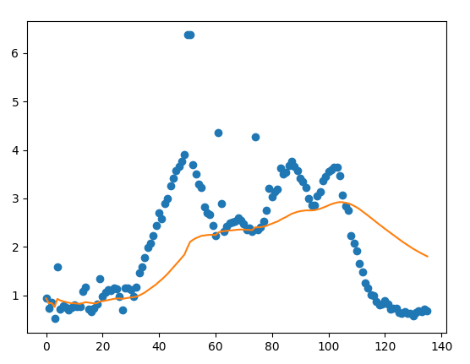
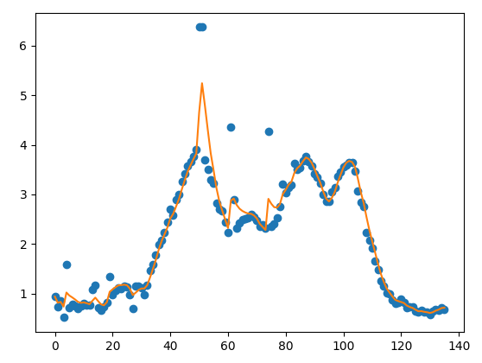
dT=0,02
When it really ISNT!
This is wrong initialization
dT=0,33
Which is way closer to the real FPS
The code NEEDS to have an idea of the FPS it will be running at BEFORE initializing kalman filters
OR the delta T must adapt and the matrices be recalculated

Slide 5
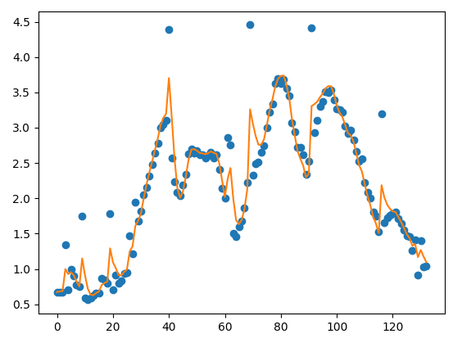
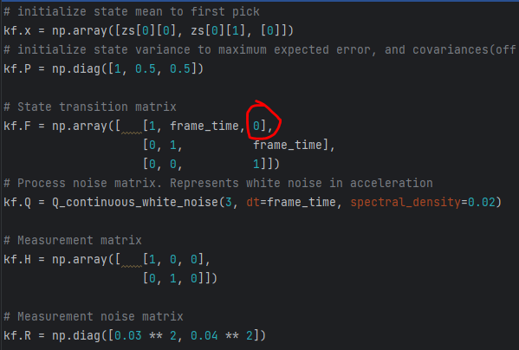
With initialization sequence of 2 updates we get
dT = 0.533
We can see that there are no toooo many ”way off” outliers
using the mask as fusion.
However we would still benefit from gating.

Slide 6
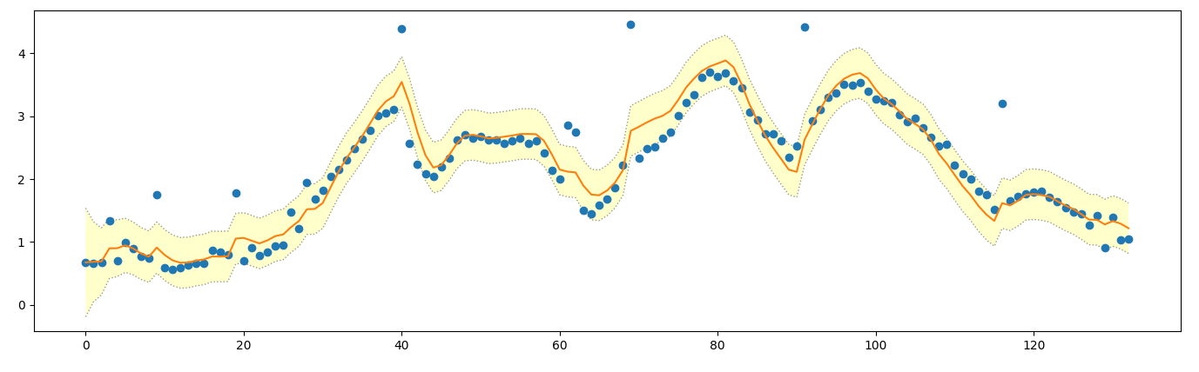
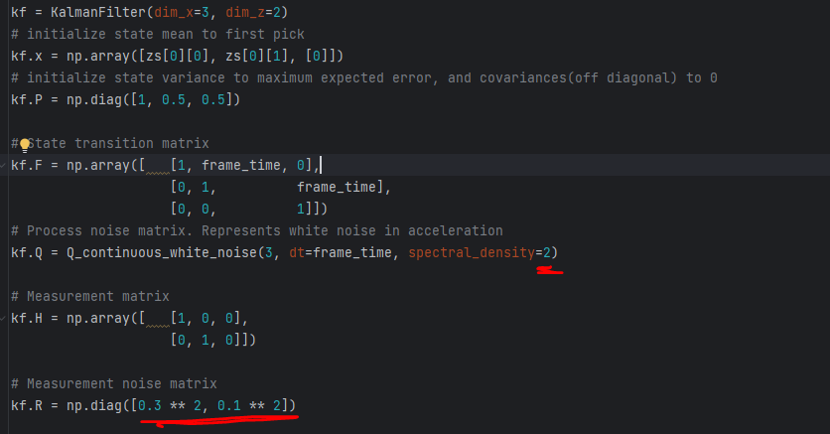
3 Sigma lines drawn on top.
98% of detections should be within yellow lines if were to assume
That filter is correct… well no. The outliers do us bad.

Slide 7
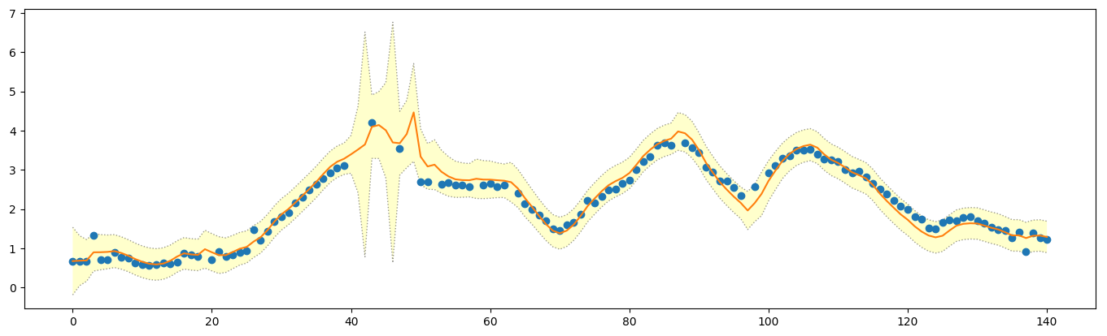
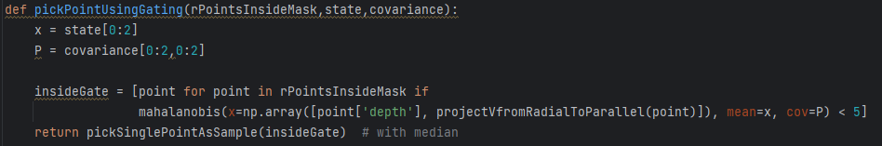
Mahalanobis gating taking < 5 sigma values in
Also we now show times when no measurement arrived

Slide 8
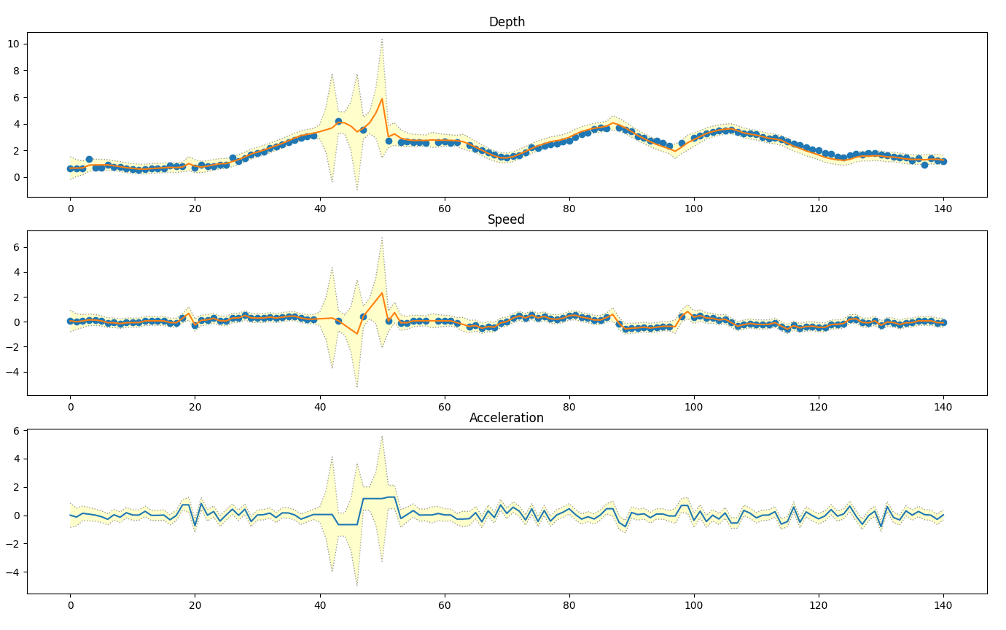
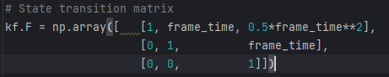
Comparison 1/2 of process model
Higher variance

Slide 9
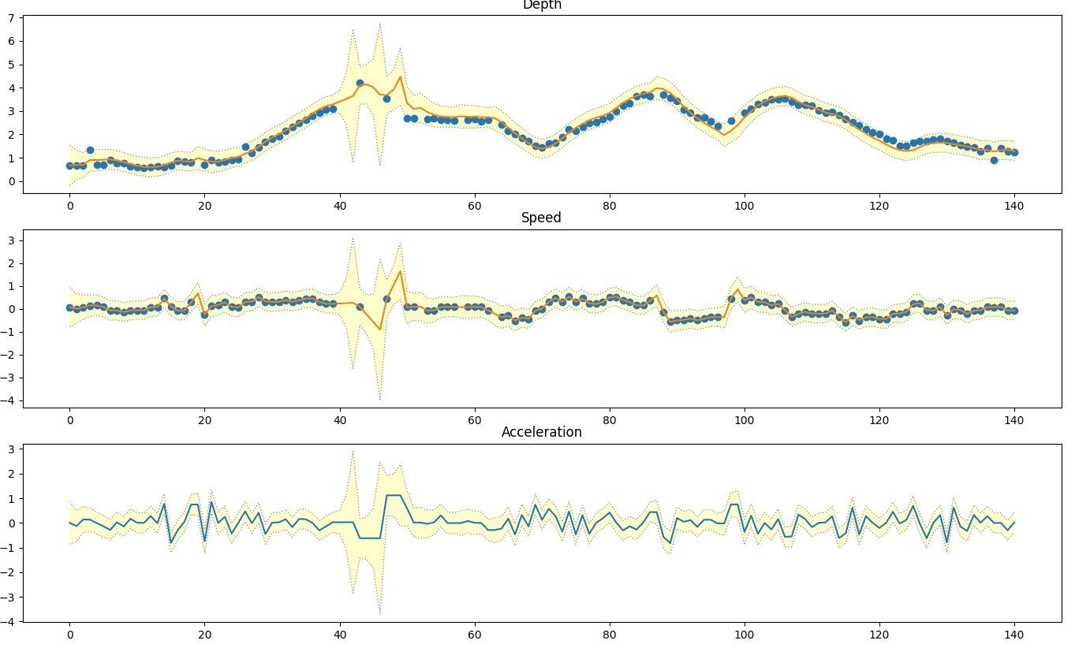
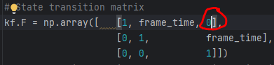
Comparison 2/2 of process model

Slide 10
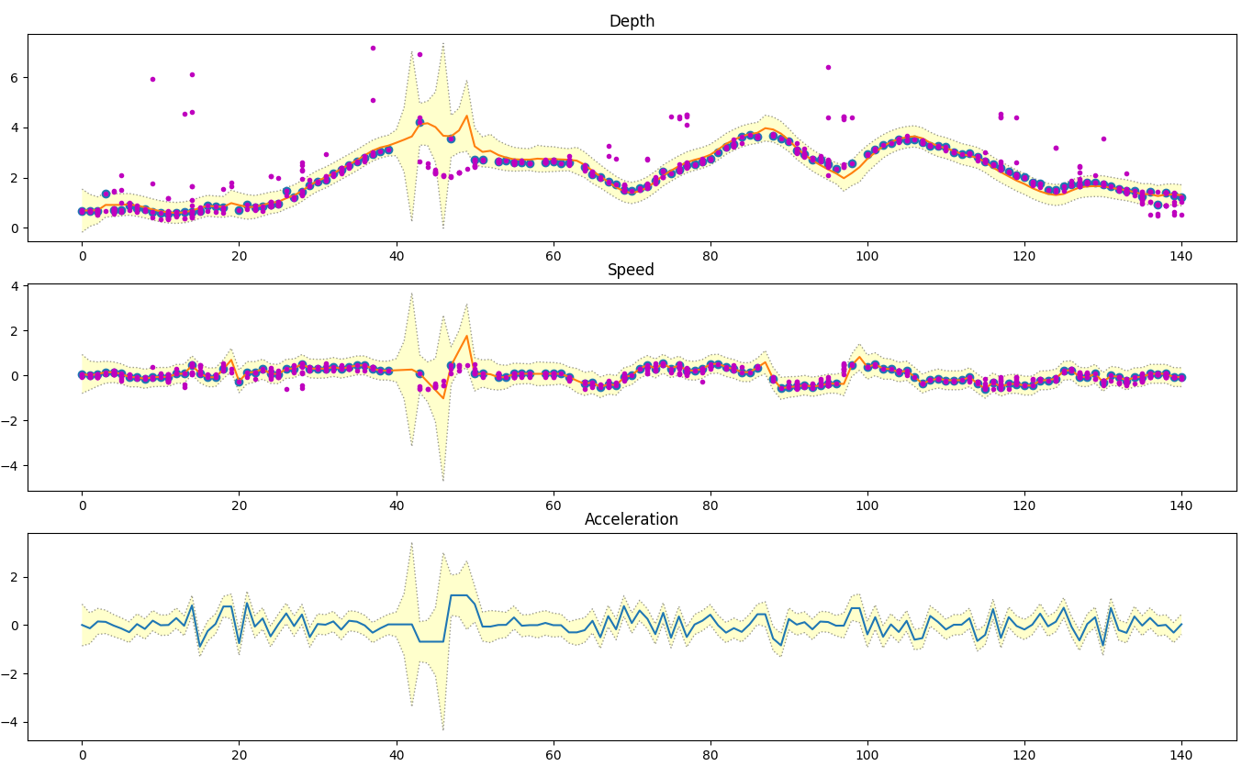

If we impose all points we see that the mahalanobis gating is doing bad

Slide 11
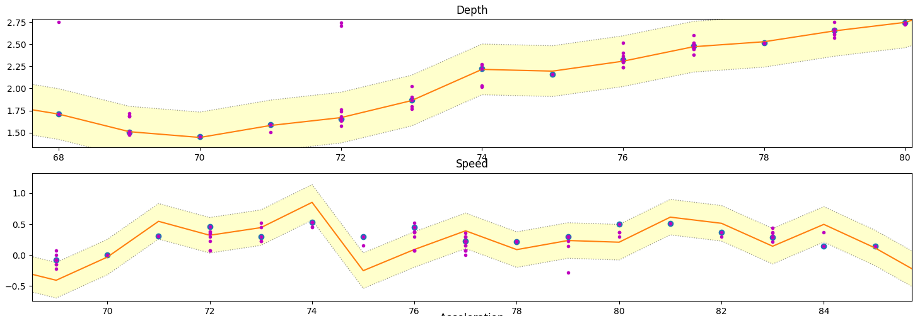
We want to find the measurement covariance, R. For that we look at places where we have a lot of points from single object.
These lines are fit so that MOST points should lie inside the lines. The results are:
Var_depth = 0.1**2
Var_speed = 2**2
Even though the resolution of the speed measurement is good, the standard deviation
From multiple speed measurements is actually quite bad. Depth is the more accurate measurement
A little bad is that depth is calculated from speed. Speed is not defined by depth
In any step of the filter. But thats just by desing. Such is Kalman.

Slide 12
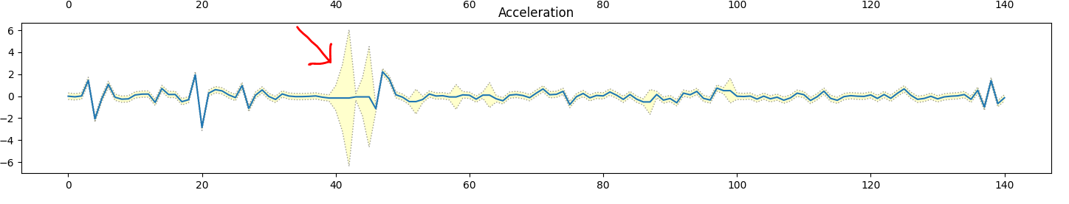
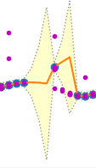
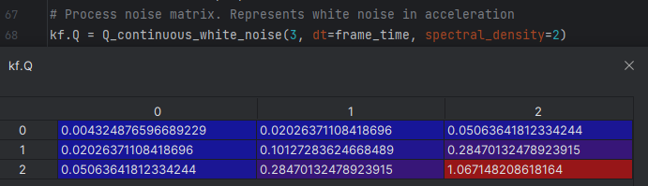
Something wrong with process noise matrix Q? When we dont see any measurements it expects
Acceleration to rise FAST. This is not at all the case in real life, if someone doesnt start running suddenly

Slide 13
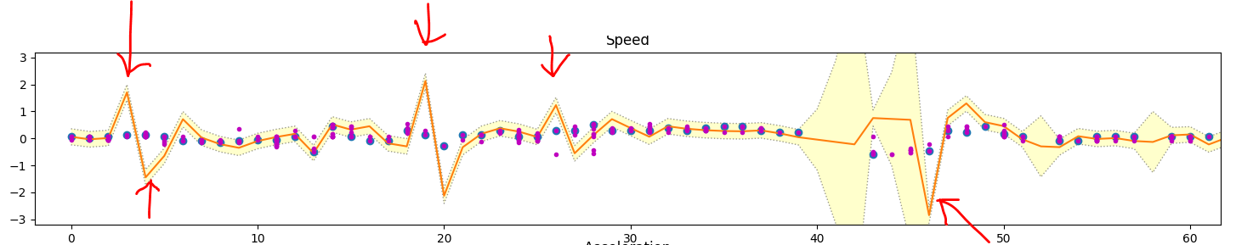
Theres also these weird overshoots of speed. This has to be due to acceleration??
Acceleration (hidden variable) is not really doing us good here.
This is possibly a MODEL issue. We see that the measurement is sane, but that means the prediction (prior)
Is going rogue.
This ”cant” be fixed by raising process noise. That only gives less trust to this faulty prediction. We need to fix
Why this prediction is faulty to begin with.

Slide 14
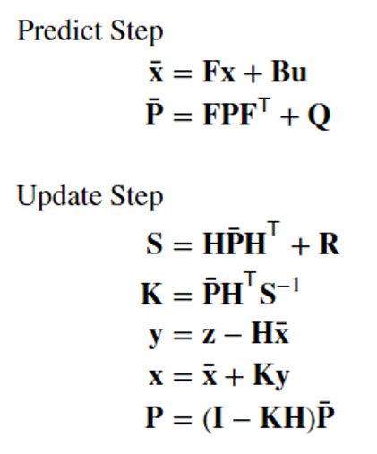
The a values changed with Kalman Gain, K
K is affected by R. Also P which itself depends on F and Q
So actually the process noise, Q really does have an effect.
We are assuming: acceleration stays constant through all delta T. This might be what is leading us to demise. It is not
True in the real world. We could assume speed is the same, but not acceleration. Model order doenst match the world

Slide 15
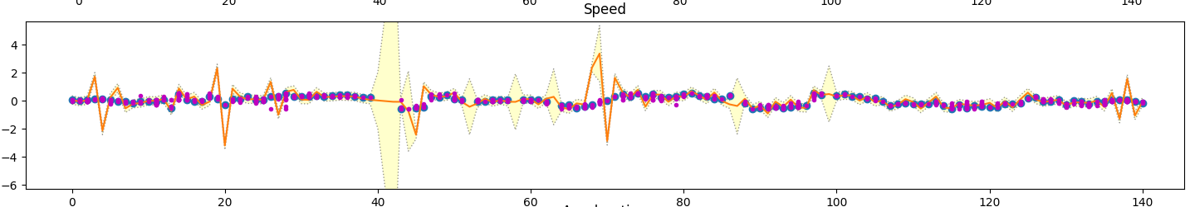
Lets try very big process noise Q
10x the process noise by doing spectral_density = 20 instead of 2:
Speed STILL has those spikes. Not ok. Q does not fix our problem

Slide 16
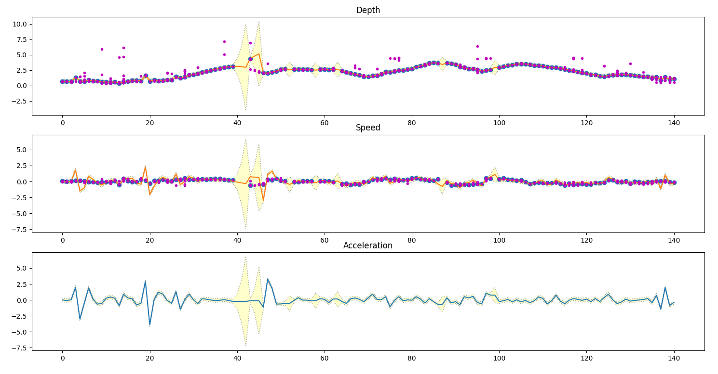
How about we change our process noise?
Go from
to
No effect on
Speed bumps

Slide 17
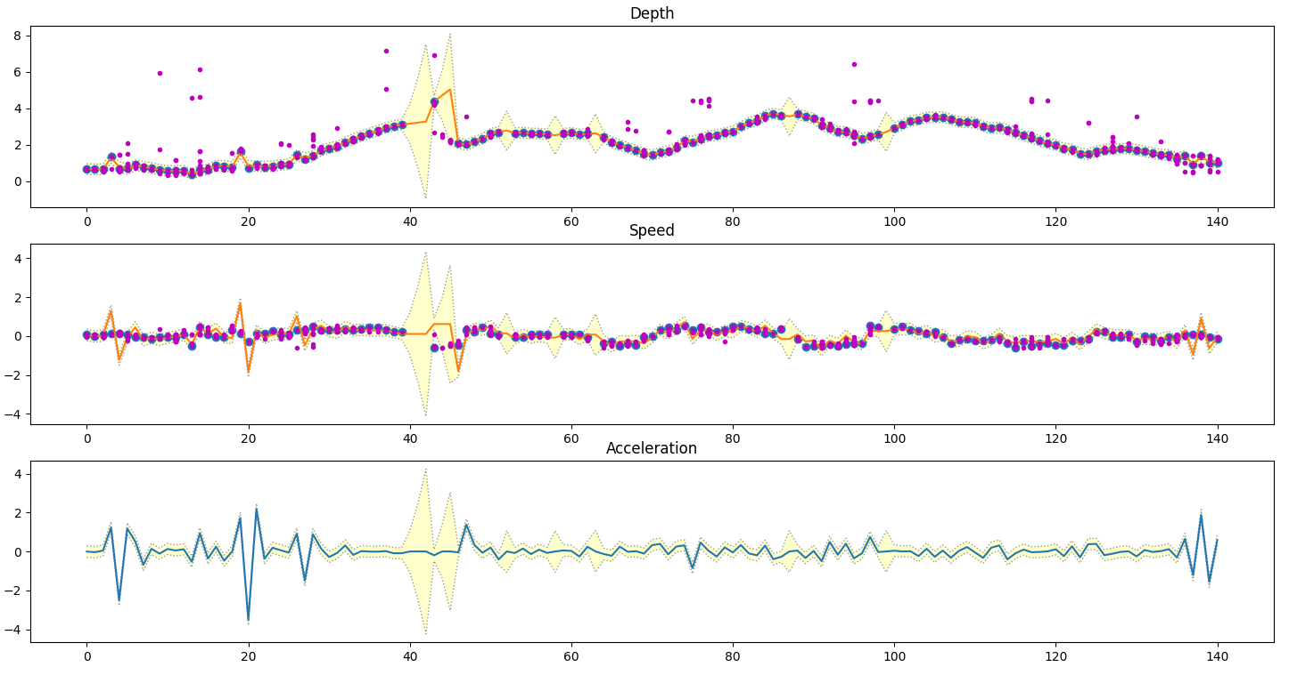
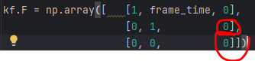

REMOVE effects of acceleration on speed in F
And dont remember your
acceleration
STILL!!!
Why are there spikes in the
Speed??
Heck…. Yes the spikes actually belong there because:
The depth estimate is trusted a lot. When K recalculates how to do prediction, it predicts a speed change because we
Saw a Trusted spike in the DEPTH. The depth therefore is the one that breaks the speed, not the acceleration.
The issue lies in measurement noise matrix, R

Slide 18
Ok, well. Previously we looked at how many points are inside 3std and defined measurement noise matrix R based on that.
Is that good?
Well, yes. In fact i believe the measurement is good. Its just that it comes from a reflection. Not the object itself.
Well. It could be part of the same object put further away if the object is large. This we will just have to deal with.
We cant give a real object that is 1 meter in depth a clear depth measurement with radar as the depth can
range anywhere inside the 1 meter and that would still be a ”correct” measurement. The object just
happens to be large.
The kalman filter does not take this into account. It believes the object is a point source. What i want however
is that the speed calculation is not done from depth in this case, as this is wrong.
Case: object is stationary, but we get reflection first of its back and then at its front->
Speed calculated from depth for 1 meter long object with 1 second dt = 1m/s even thoug in reality
the object is stationary and we just happened to catch the front and back of it. In this case the velocity
measurement should be trusted.
EG. In re-calculation i would want to trust the velocity more. The velocity IS accurate. It just has a lot of
variance in what results it gives out.

Slide 19
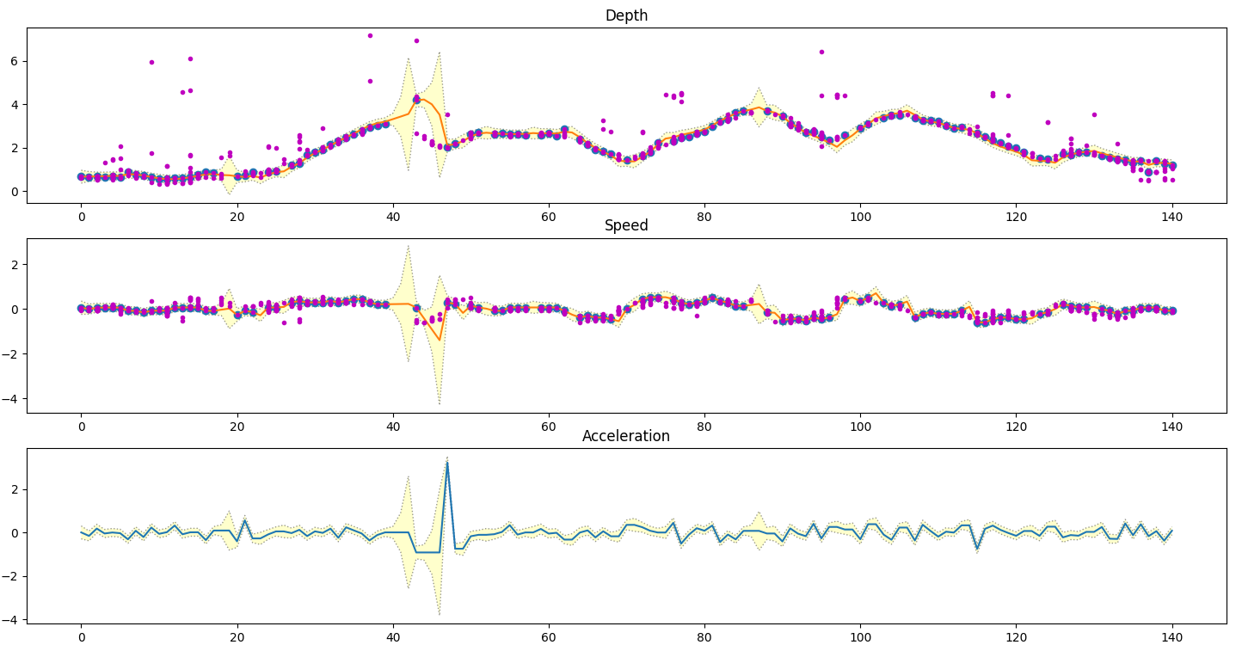
So: trust the velocity, Lets try that in measurement variance R again, as changing Q (in its two forms) did not help
How much more do we need to trust the speed in order for there not to be a bump?
The Q might be making this harder? It says to trust the speed less than the velocity
Speed bumps are gone when
Depth=0.1**2
Speed=0.02**2
BUT! This also is due to the points that caused
The bumps not being included as chosen points
By the mahalanobis. We reversed the observed variences for this effect

Slide 20
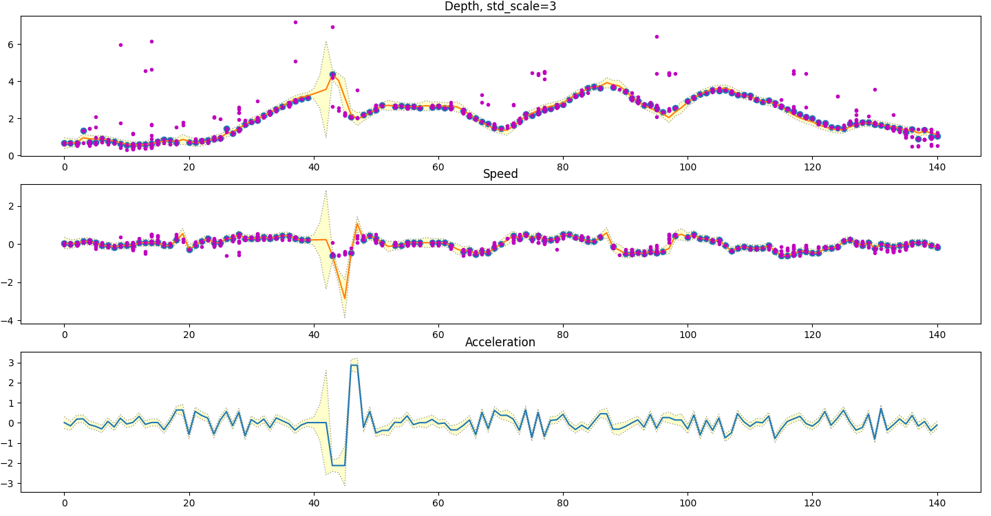
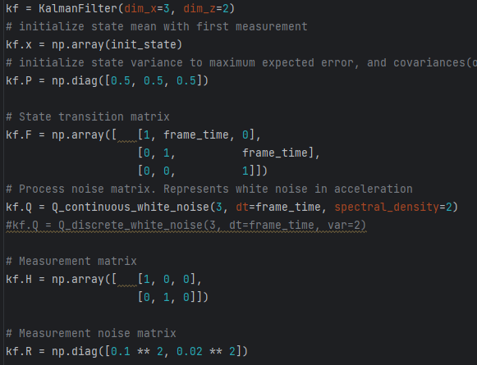

Slide 21
In all the previous simulations we see that our hidden variable, acceleration, is very noisy and is often
Detrimental instead of good in its prediction. We simply cant assume that acceleration would be constant.
This happens especially in the ”no measurement” parts of the dataset. We simply cant assume acceleration
Is present if we dont see object with radar. In fact, the actual main() code would turn acceleration to 0 if
The object was not moving based on camera. This camera based movement stop is not incorporated into
This dataset.
Anyway, what this means is that our model order is too high for this sort of tracking. Acceleration simply
Does not give us sane results. We could try removing it.

Slide 22
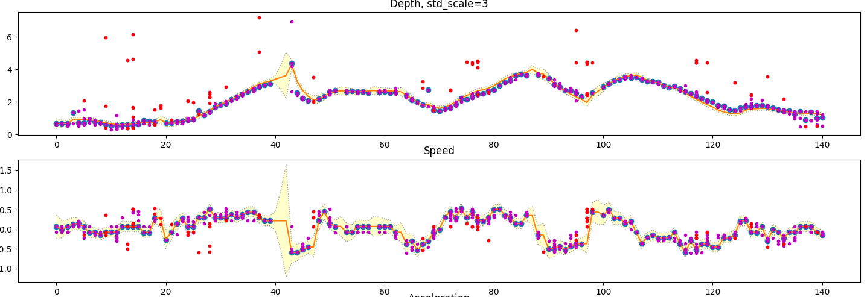
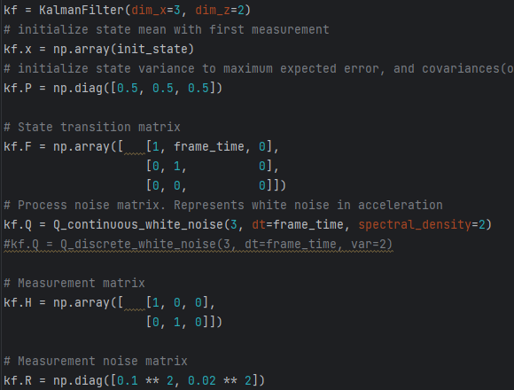
In red we plot points discarded by Mahalanobis < 20 gating
These REAL points where i actually change
direction were excluded by gate
NO acceleration model
Keep in mind: If you change covariances after this then the P used by
Mahalanobis will also be affected and you may have to redo it

Slide 23
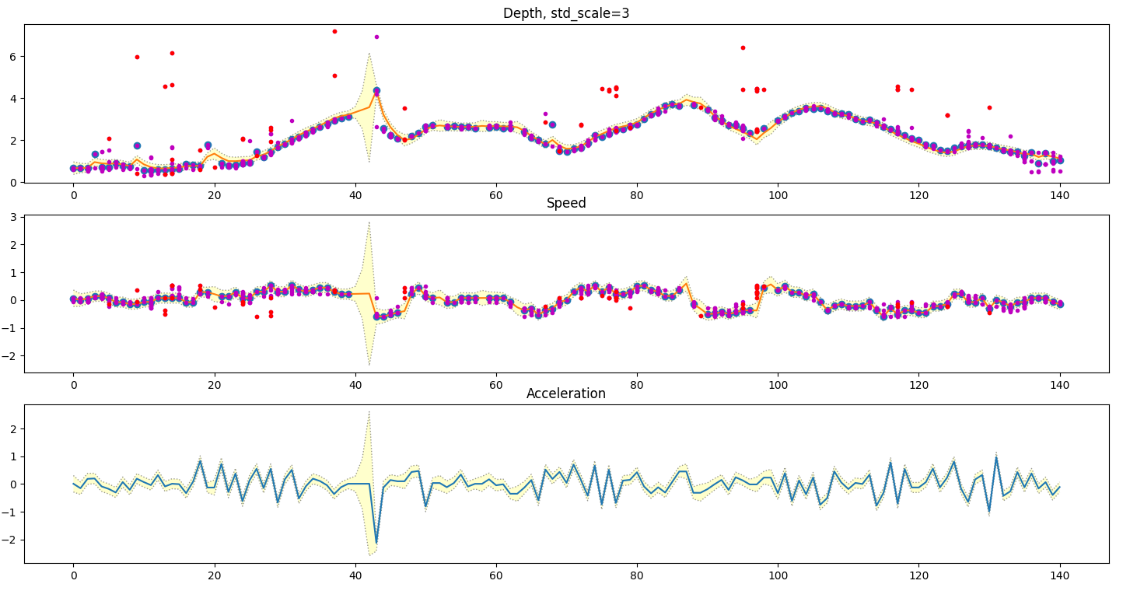
The same as above but with acceleration
Variances are higher. No benefit from acceleration

Slide 24
Use same filter order in UKF (no acceleration)
Yes, so we remove the acceleration:
Next:
Find best linear filter coefficients
Move to Unscented Kalman Filter
Compare

Slide 25
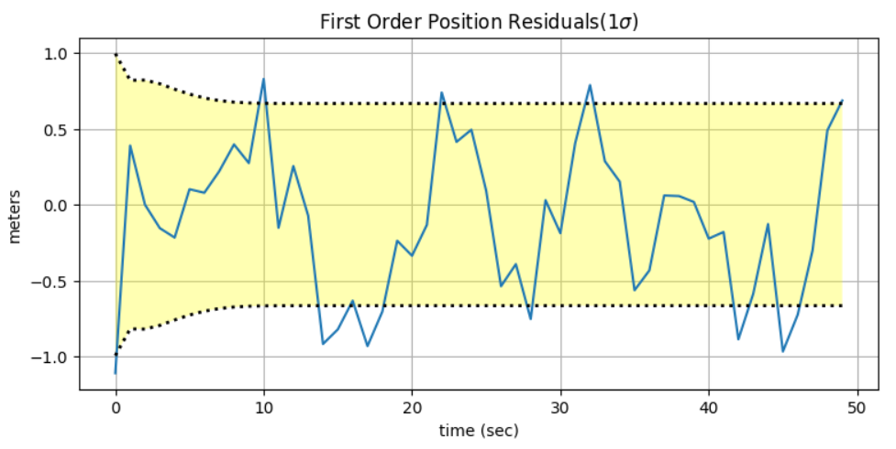
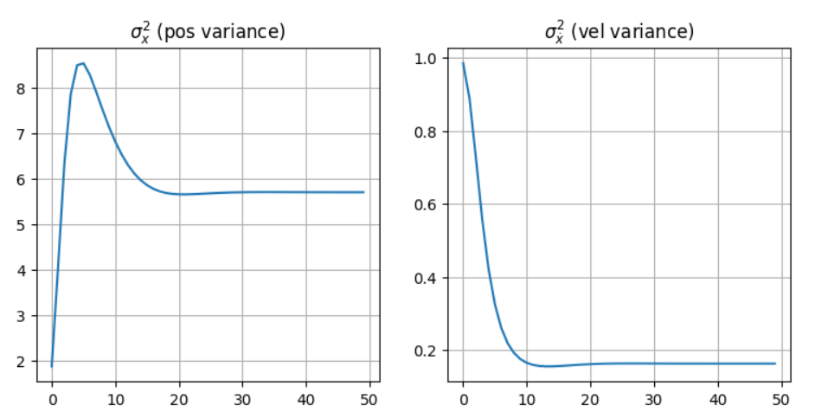
In addition, what do we look at in linear fitting other than that it looks good:
Residual looks like noise around 0
This also tells about the filter order (vs the order of the phenomena in real worl)
Variance tends toward a low point
Like the vel. NOT like pos

Slide 26
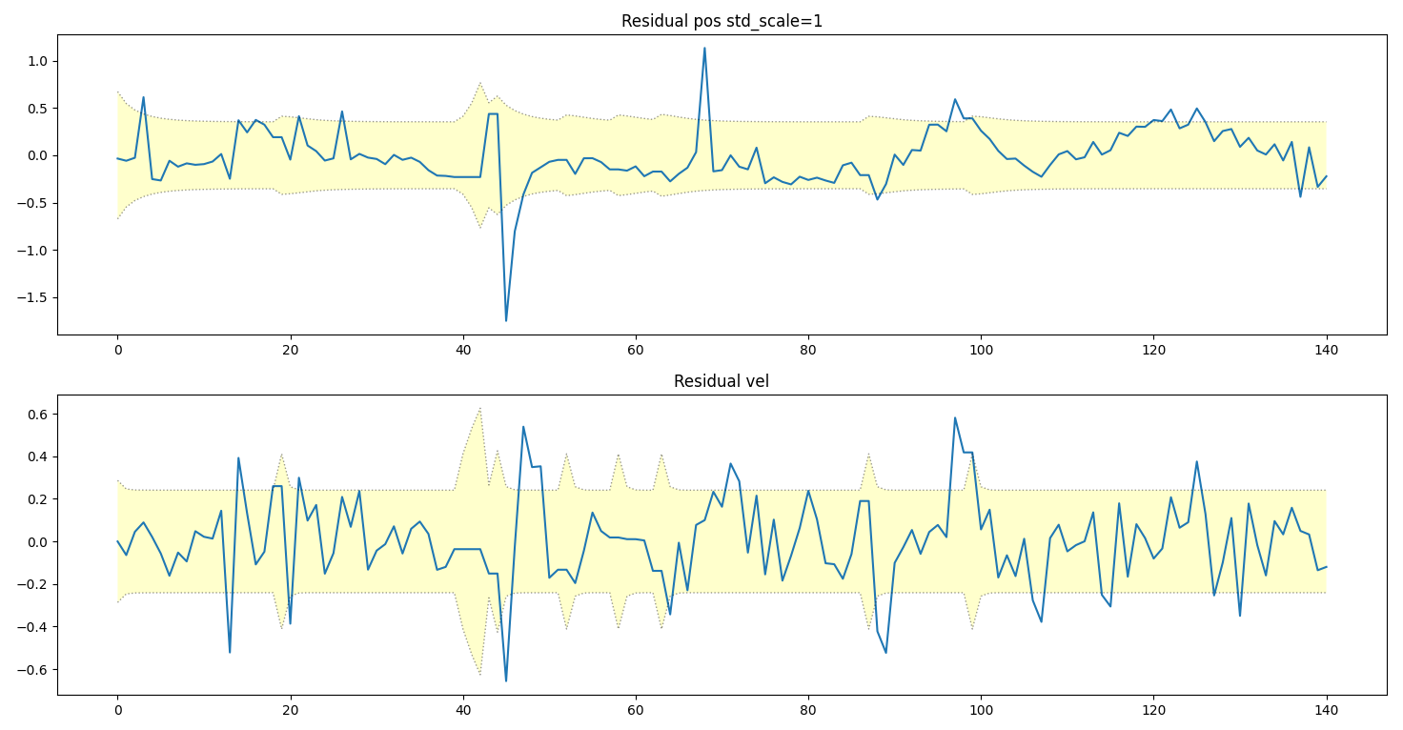
We spot that our residuals did not conform to even within 3 std with the previous measurement and process noises.
We tought the system was better than it actually is.
1/2
More noise makes the system conform to even 1 STD residuals (instead of 3STD):

Slide 27
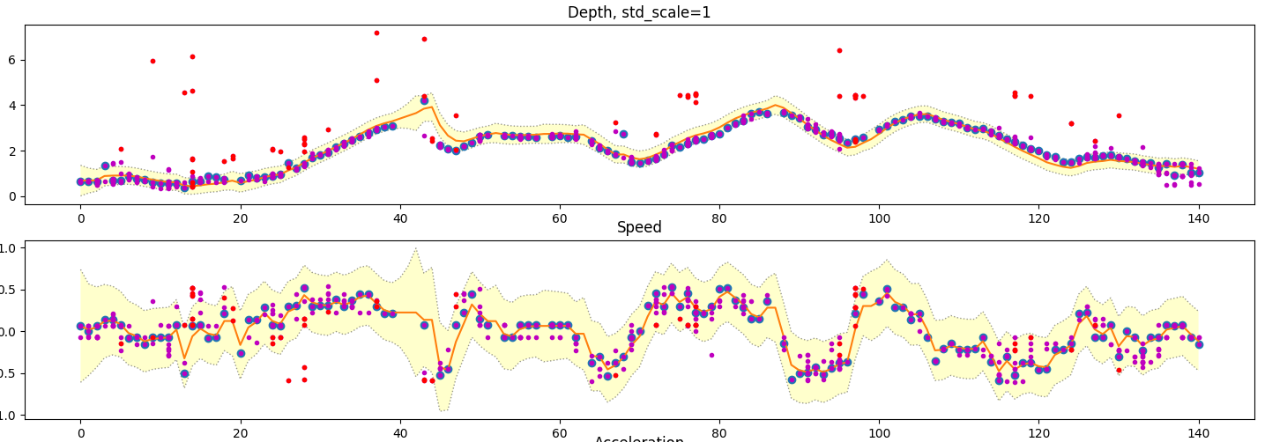
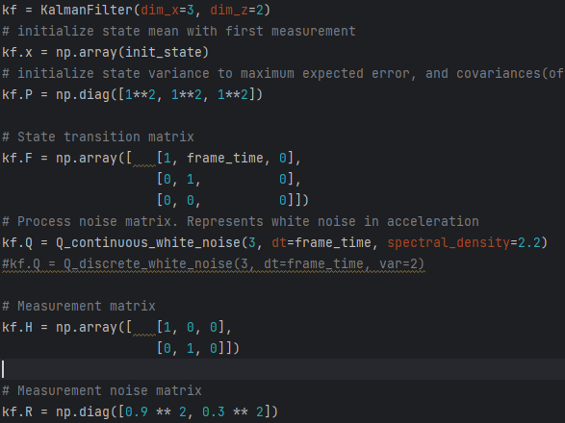
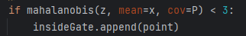

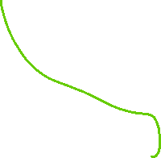
2/2
The variance bars in speed look large but you can see that we
Need them to be large as the human CAN move suddenly

Slide 28
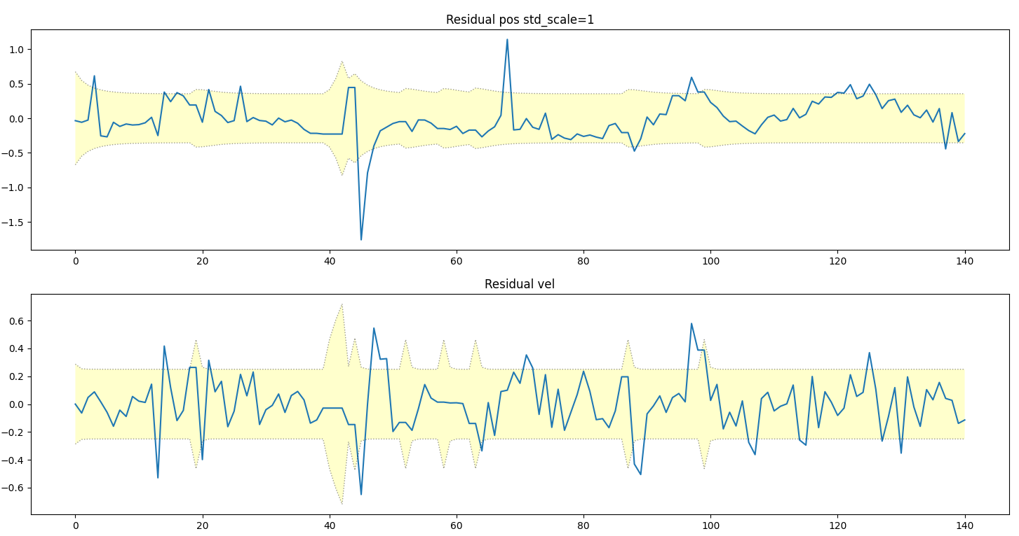
1/2

Slide 29
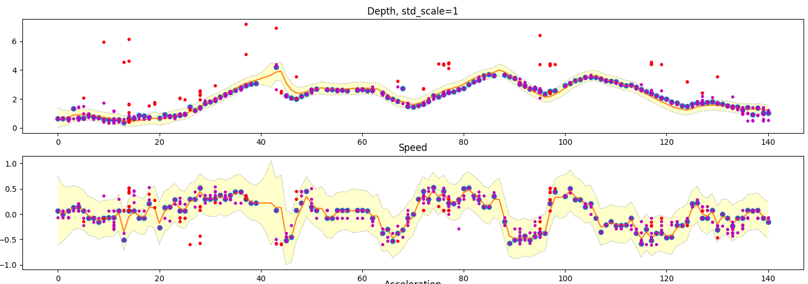
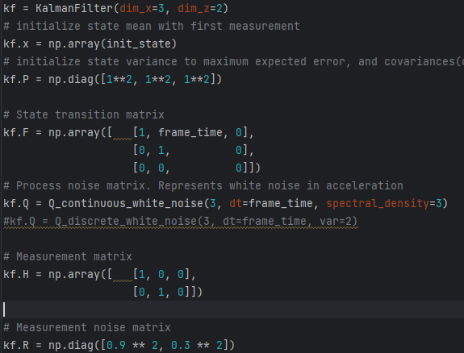
2/2
Depth still looks to trust the prediction a little too much. Speed is ok.

Slide 30
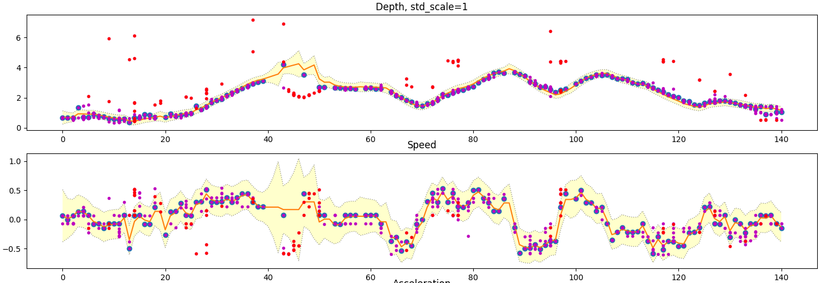
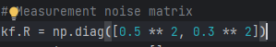

Based on previous i gave a little more trust to the depth. This turned out to be good for normal case, but bad
For the unexpected movement of the object when we have no measurement
It will converge again, but it can take some time for the variance to grow until mahalanobis no longer Gates the
Measurements that are in unexpected region.

Slide 31
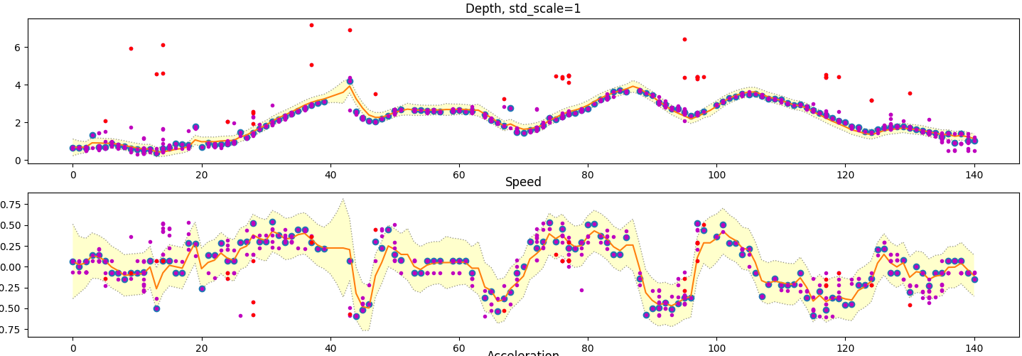
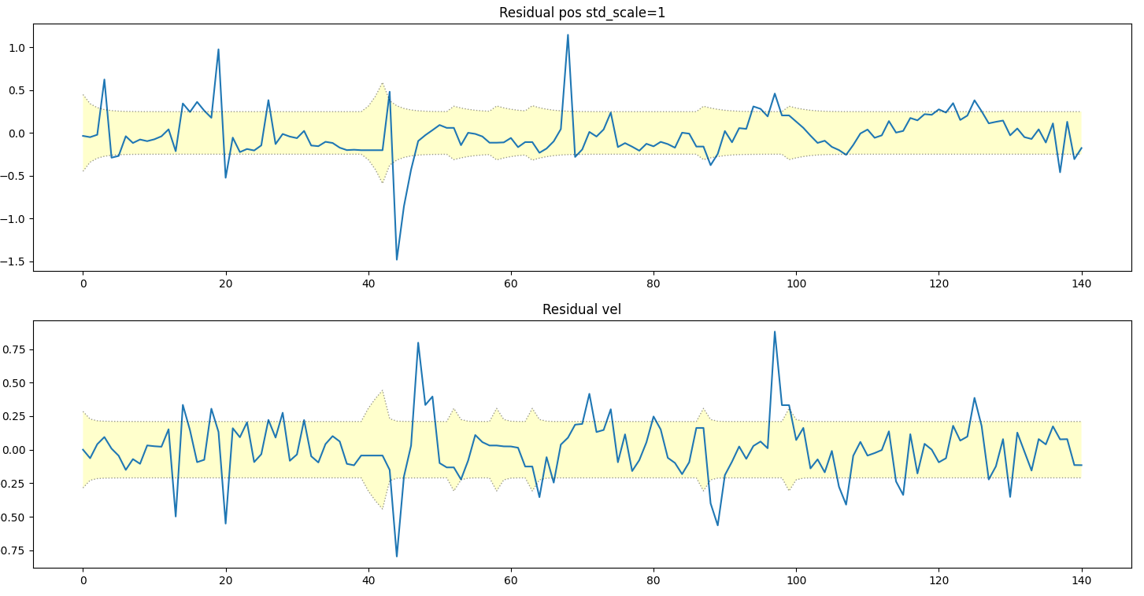
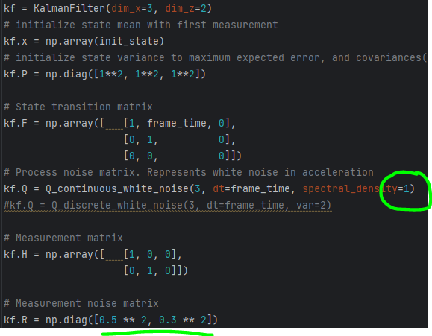
Ideally we want to have as much information as possible for the filter. Therefore the gating should only take out
CLEAR outliers. Not the neighbourghoods. -> Increase mahalanobis
Results look REALLY good. I trusted the process
Model more so that speed is not as jumpy.
Also gave more trust to depth.
Speed now less pronounced

Slide 32
I am satisfied with the above filter. Now we need to gather more datasets to test whether it will generalize

